Slide 1

Cancer Treatment Management System
Presented by :
Anusha Prakash Diya Gandhi
RUTU GAWAD

Slide 2

Problem Statement
Cancer treatment is a complex process requiring coordinated efforts between multiple roles in the healthcare system. The challenge lies in managing the vast amount of information, ensuring timely communication, and analyzing patient and hospital data for better treatment outcomes. Additionally, a robust authentication mechanism is critical to safeguard sensitive patient data.

Slide 3
Project Objectives
1. Design and implement a role-based Swing application to simulate the cancer treatment management process.
2. Create dashboards for summarizing patient treatment details, hospital resource allocation, and overall progress tracking.
3.Enable communication between various stakeholders, including doctors, nurses, lab technicians, and administrators.
4.Implement robust authentication for secure access to the system.
5.Provide a reporting module to generate analytics and identify trends in treatment
6.effectiveness and hospital resource usage.

Slide 4
Roles
Government officer
Government Secretary
Government Treasurer
Healthcare Accountant
Healthcare Officer
Insurance Financier
Insurance Agents
Insurance Policy Planner
Patients
Doctors– Oncologist, Radiologist
Nurse
Admins
Lab assistants
Pharmacist

Slide 5
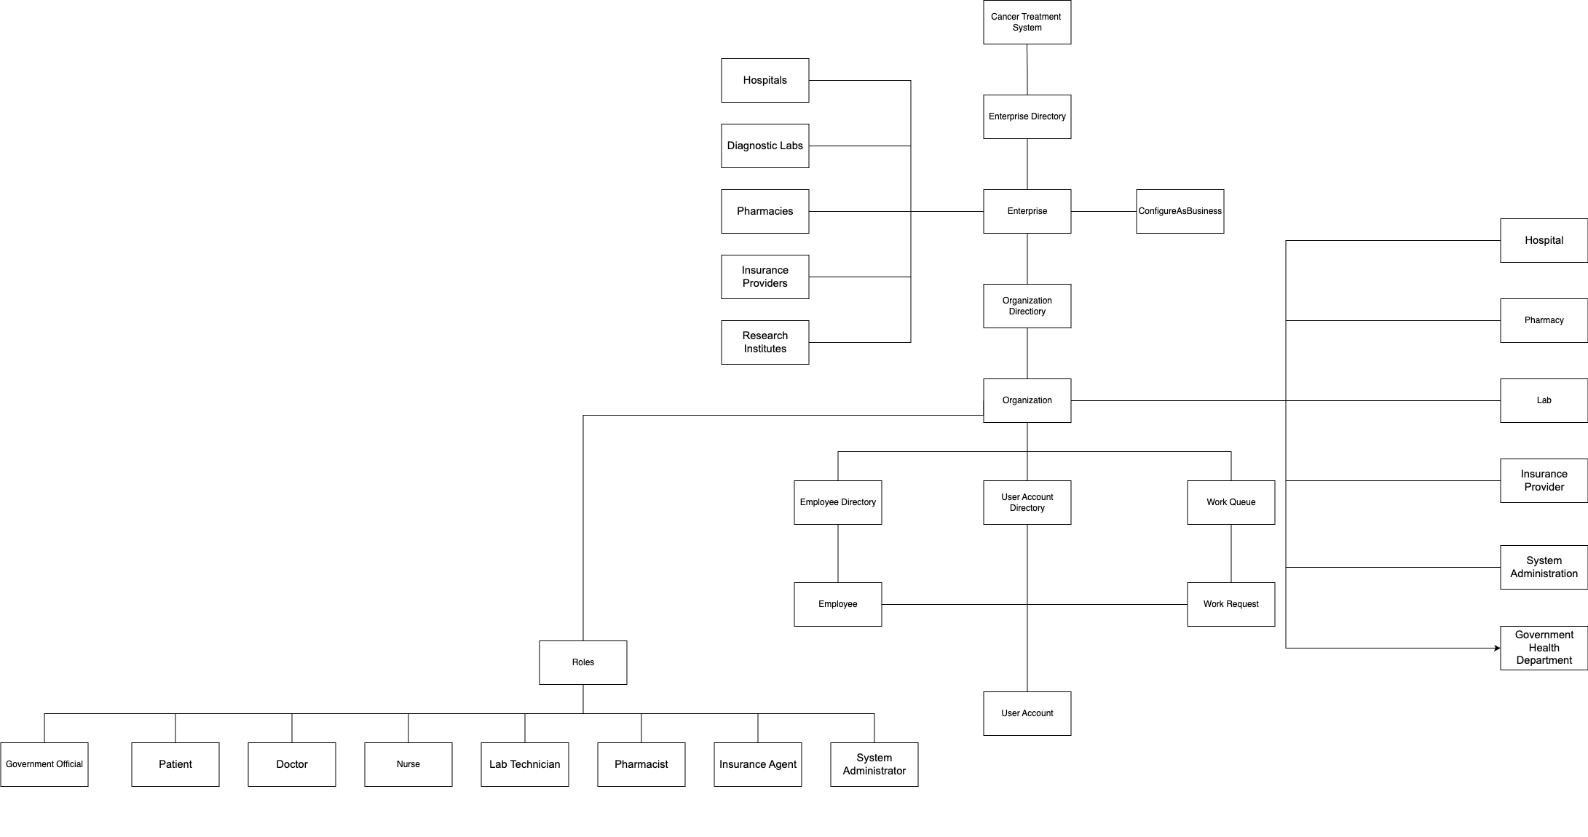
UML Class Diagram:

Slide 6
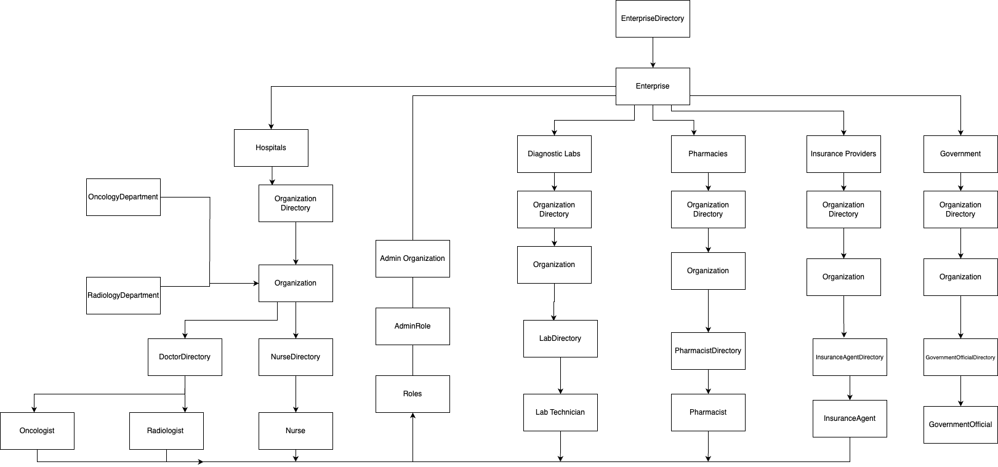
High Level Component Diagrams:

Slide 7
Advance Features
Role Specific Dashboards: Tailored dashboards for doctors, nurses, patients, and administrators to show only relevant data.
Role-Based Authentication: Ensures users only access information they are authorized to see, protecting sensitive patient data.
Impact: Doctors get real-time access to lab results, nurses can track patient status, administrators can manage resources, and patients can view their treatment progress.

Slide 8

THANKYOU

